Slide 1
Intercultual diversity inventory
Sierra Pacific Synod
Bishop’s Convocation 2022

Slide 2
What is IDI?
The Intercultural Development Inventory® (IDI) is a theory-based assessment of intercultural competence -the capability to shift cultural perspective and appropriately adapt behavior to cultural differences and commonalities.
The IDI is a 50- item , cross-culturally generalizable, valid, and reliable assessment of intercultural competence available online that can be completed within 15-20 minutes.
IDI as a developmental tool.

Slide 3
Shared Definitions: WHO, WHAT, HOW?
Culture
Subjective Culture – Patters of interpretations and behavior learned from one’s group that guide individual and group activity.
Objective Culture – the artifacts and institutions created by a group of people, reflected in such areas as art, architecture, dance, literature, holidays and collective history.
Diversity – the mix of differences. It is the who question.
Inclusion – Making the mix work. It is the what question.
Therefore, intercultural competence is about making a diverse environment inclusive. IDI is the how.

Slide 4
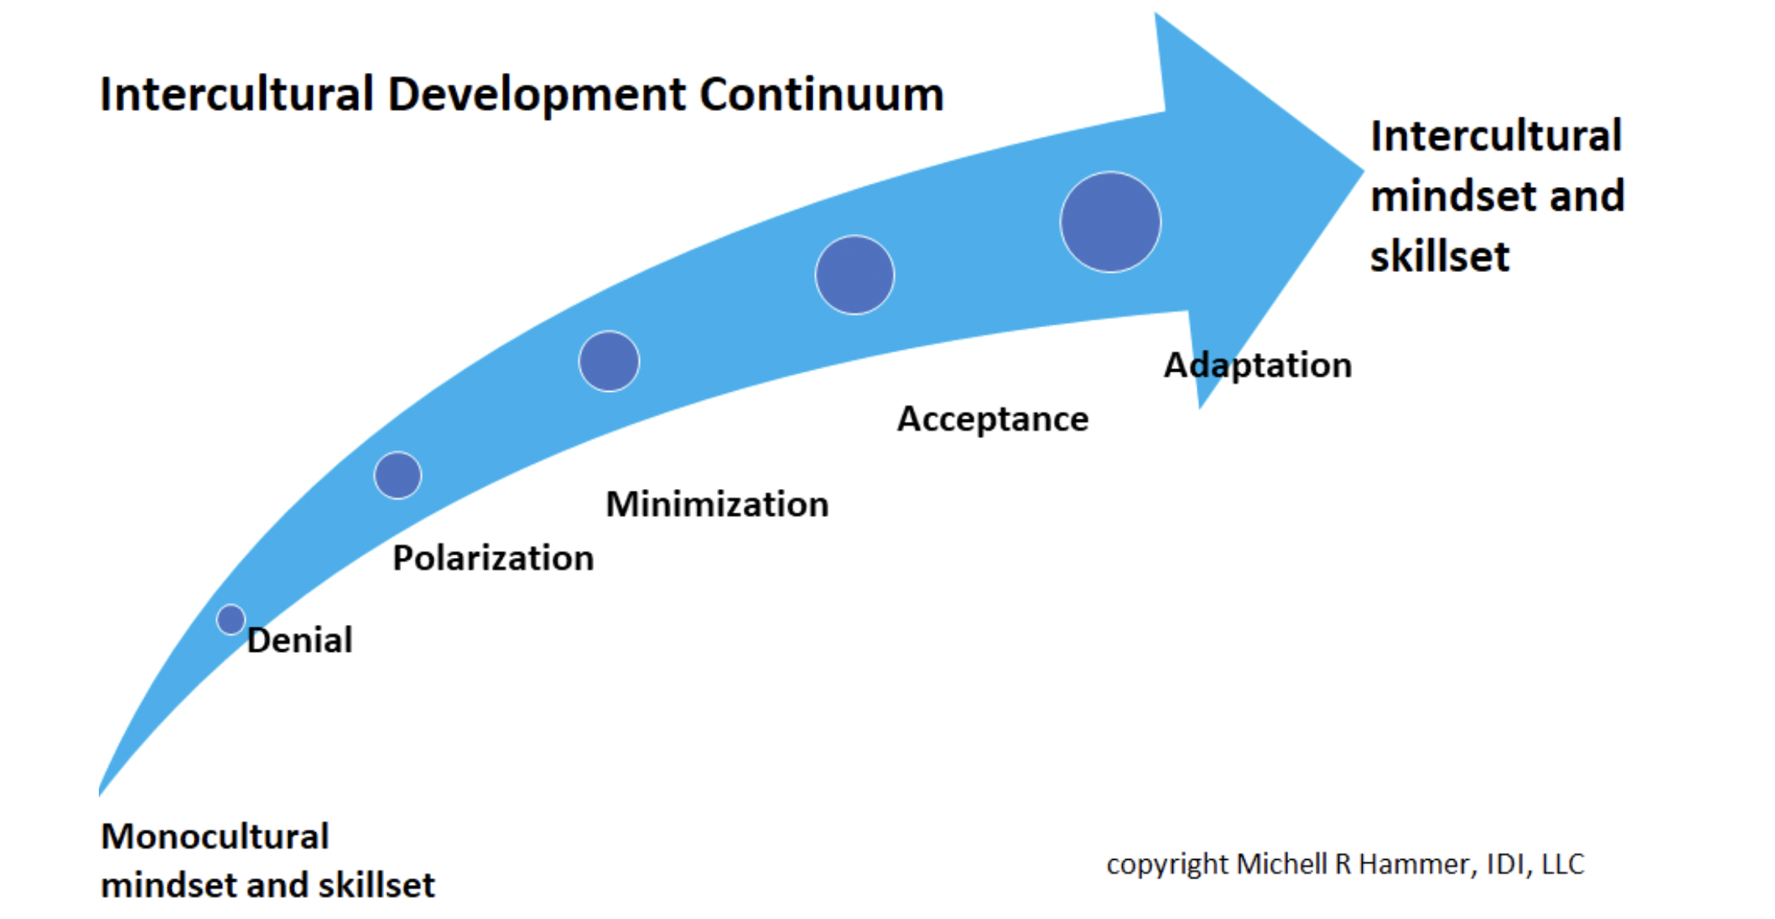
The IDI continuum

Slide 5
Next Steps if you want to take IDI
Contact an IDI Qualified Administrator
There is a fee - individual or group
Take the IDI Assessment – confidential, non-judgmental
Schedule a Debriefing
Receiving the result of your assessment
45 minutes to one hour
Includes Intercultural Development Plan
Formation Journey continues…

Slide 6
Sharing and Q&A

Slide 7
IDI Qualified Administrator
Contacted Individual QA
Rev. Ben Sandin: bsandin@bethelcupertino.org
Rev. Laura Eberly, founder of Mountaintop Coaching and Consulting: leberly@gmail.com
Rev. Tita Valeriano: titav@spselca.org
Other institutions
Reconciling Works: https://www.reconcilingworks.org/resources/
Rev. Julie Boleyn, Regional Director, Upper Midwest, Kaleidoscope Institute: julie.boleyn@kscopeinstitute.org

Slide 8
Learn more
https://idiinventory.com/

